Slide 1

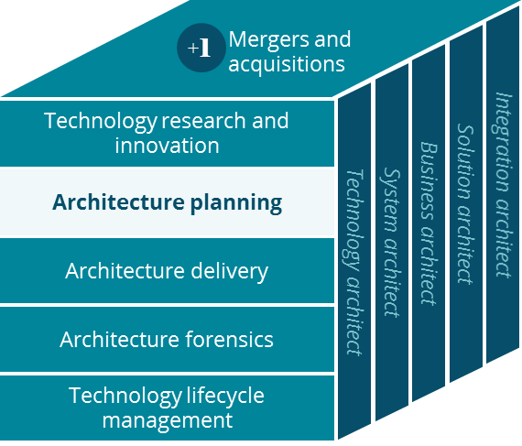
Long Term Care Business Canvas
Architecture Planning
Tom Weiss, Mary Potts-Hozlock, Ravi Vangala
6/20/2019

Slide 2
Long Term Care Business Canvas
Holistic view of the current LTC business model
Key Partnerships
Key Activities
Value Proposition
Customer Relationships
Customer Segment
Rx drug fulfillment
Delivery to facility / home
Individual patients & care givers
Post-Acute (skilled nursing) facility administrators and clinical staff
National account executives and administrators (chains)
Senior Living (assisted living) community administrators
Other institutional care settings
PBMs
Nursing homes/ senior living facilities
Prescription drug fulfillment
Targeted clinical support
Adherence programs
Proactive care to support patient health
Medication cost management
Medication charting services
Predictive fill service
Variety of medication packaging offerings
Prescriber outreach intervention
Emergency dose/first dose solutions at facility patient point-of-care
Nurses can view order fulfillment status (especially new admissions)
Consulting Rph, Patient care mgmt.
Clinical activity, medication charting
Manufacturers
Covermymeds
US domestic population
Inventory management
Formulary management to LTC facilities
Suppliers
LTC facility EMR solutions
Compounding and intravenous fulfillment
Channels
SureScripts (route eRx)
RxClaim pricing compliance
Key Resources
In person
Email
Skilled Rph and technicians
Courier services
RelayHealth
CVS Pharmacy
Phone
Web/ Mobile app
Local real-estate
Account managers
Prescribers
Omnicell (automation)
Supply-chain & Logistics
Consultant nurses
Text
Home delivery
Cost Structure
Revenue Streams
Pharmacist wages are most expensive with about 75,000 pharmacists across 10,000 stores paid at ~$65/hour. Several state regulations require Rph overlaps.
Timely prescription fills and care management
at a convenient local store or delivered to home.
Store real-estate is very expensive especially in urban areas.
Our customers pay us by leveraging their health insurance services as well as their portion of the co-payment via cash or credit/debit cards
Pharmacy operations, Account management
Emergency dose assets, med carts, fax machines
Direct invoicing to Post-acute facilities for Medicare A and Managed Care residents, Consulting Rph & nursing services, MDM (medication data management)

